Slide 1
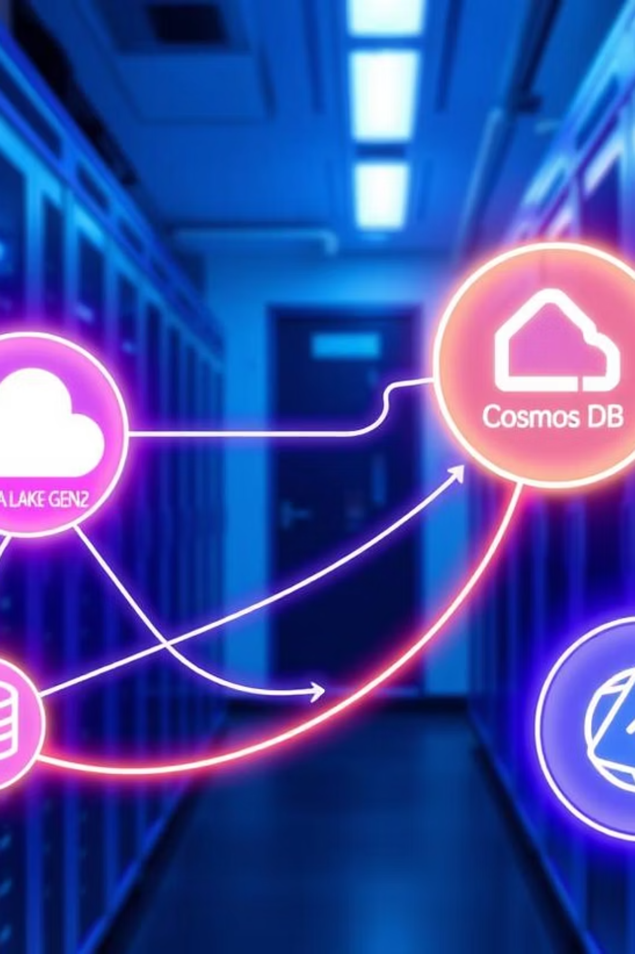
Building an ETL Pipeline with Azure
Explore a structured approach to designing and implementing a robust ETL (Extract, Transform, Load) pipeline using key Azure services. This presentation will guide you through efficient data movement, transformation, and storage strategies, tailored for data engineers and architects.

Slide 2

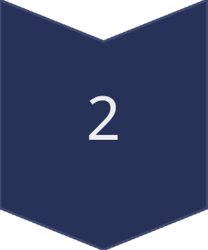
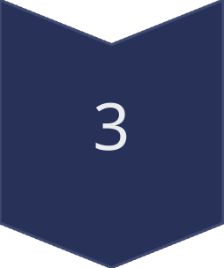
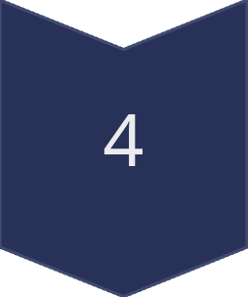

Agenda
Key Stages of Our Azure ETL Pipeline
Data Ingestion
From Blob Storage to Data Lake Gen2
Data Transformation
In Data Lake Gen2
Data Loading
To Cosmos DB & Synapse SQL
Monitoring & Optimization
Ensuring Performance
Security & Governance
Protecting Your Data

Slide 3
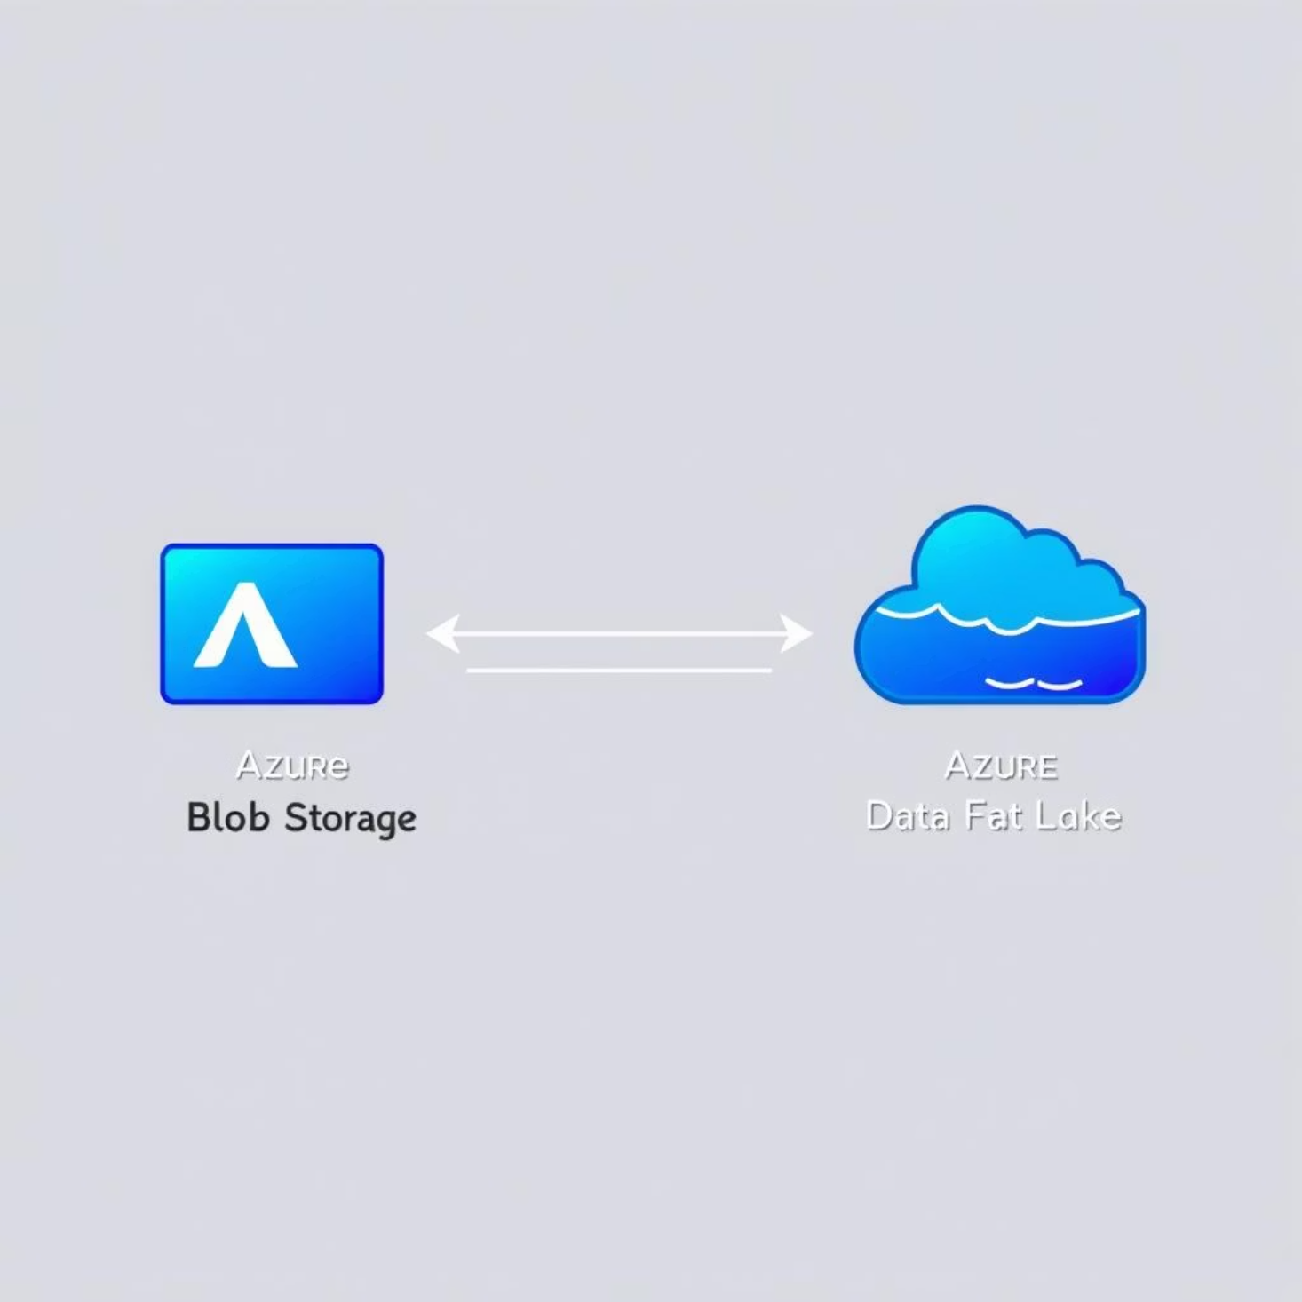
1. Data Ingestion from Blob Storage
The initial step involves extracting raw data efficiently from Azure Blob Storage, serving as our primary data source.
Source: Azure Blob Storage
Tool: Azure Data Factory (ADF) for pipeline orchestration
Process: Utilize ADF's Copy Activity to move data to Data Lake Gen2.
Optimization: Implement chunk-based copying for large files to enhance performance and reliability.

Slide 4
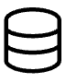


2. Data Transformation in Data Lake Gen2
Once ingested, raw data undergoes crucial transformations within Azure Data Lake Gen2 to prepare it for analytical and operational use cases.
Structured Storage
Mapping Data Flows
Schema Drift
Store raw data in optimized formats like Parquet or Avro for efficient querying and reduced storage costs.
Leverage ADF's Mapping Data Flows for sophisticated transformations (filtering, aggregation, joins) with a visual interface.
Enable schema drift detection to automatically handle evolving data formats without manual pipeline adjustments.

Slide 5

3. Loading Data into Cosmos DB for NoSQL
Post-transformation, refined data is loaded into Azure Cosmos DB, ideal for high-performance NoSQL applications.
Destination: Azure Cosmos DB
Integration: ADF facilitates seamless data transfer from Data Lake Gen2.
Data Modeling: Implement precise data mapping to ensure compatibility with Cosmos DB's flexible schema.
Automation: Schedule pipelines for regular execution to maintain continuous data currency in NoSQL applications.

Slide 6
4. Loading Data into Synapse SQL for Analytics
Alternatively, transformed data can be loaded into Azure Synapse SQL, powering enterprise-grade BI and OLAP workloads.
Loading Methods
Use PolyBase or bulk copy operations for high-throughput loading of large datasets into Synapse SQL.
Performance Enhancements
Create materialized views for frequently accessed queries, significantly reducing query execution times.
Workload Optimization
Optimize data partitioning and indexing strategies within Synapse SQL to align with common analytical patterns.

Slide 7
5. Monitoring & 6. Security and Governance
Monitoring & Optimization
Security & Governance
ADF Monitor: Track pipeline performance, activity logs, and debug issues.
Azure Active Directory (AAD): Implement Role-Based Access Control (RBAC) across all services.
Azure Monitor & Log Analytics: For advanced metrics, custom alerts, and centralized log management.
Azure Key Vault: Securely manage credentials, API keys, and encryption keys.
Auditing: Enable comprehensive logging and auditing for data lineage and compliance.
Query Performance: Optimize data partitioning and indexing in Synapse SQL.

Slide 8
Key Takeaways & Next Steps
Integrated Ecosystem
Efficiency by Design
Continuous Improvement
Azure services provide a cohesive and scalable environment for complex ETL workloads.
Leverage ADF for orchestration, Data Lake Gen2 for transformation, and specialized databases for consumption.
Prioritize monitoring, security, and governance for a robust and compliant data pipeline.
Ready to design your tailored Azure ETL solution? Let's connect to discuss your specific data requirements and architectural goals.

